Slide 1

3G & Mobile Data Networks
Overview of Architecture, Design & Case Studies
Simon Newstead
APAC Product Manager
snewstead@juniper.net

Slide 2
Agenda
Mobile overview and the transition to 3G
2.5G data networks
3G - phases of deployment. Focus areas:
  Layer 2/MPLS migration
  IP RAN and transition techniques
  IP Multimedia subsystem and QoS
  ‘Push to Talk’ example
  IPv6
WLAN integration options
Case studies

Slide 3
Agenda
Mobile overview and the transition to 3G
2.5G data networks
3G - phases of deployment. Focus areas:
  Layer 2/MPLS migration
  IP RAN and transition techniques
  IP Multimedia subsystem and QoS
  ‘Push to Talk’ example
  IPv6
WLAN integration options
Case studies

Slide 4

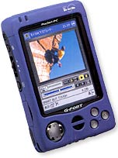

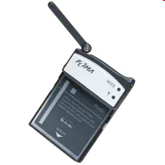
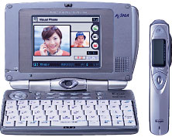
Why 3G?
Higher bandwidth enables a range of new applications!!
For the consumer
  Video streaming, TV broadcast
  Video calls, video clips – news, music, sports
  Enhanced gaming, chat, location services…
For business
  High speed teleworking / VPN access
  Sales force automation
  Video conferencing
  Real-time financial information

Slide 5






3G services in Asia –
Here and now!
CDMA (1xEV-DO)
  Korea: SKT, KTF
  Japan: AU (KDDI)
WCDMA / UMTS
  Japan: NTT DoCoMo, Vodafone KK
  Australia: 3 Hutchinson
  Hong Kong: 3 Hutchinson
More deployments planned this year and next
  eg- Malaysia – pilots 1H04, commercial deployment 2H04

Slide 6
3G overview -
IMT 2000 umbrella specification
IMT-DS Direct spread = UTRA FDD = WCDMA
IMT-TC Timecode = UTRA TDD, TD-SCDMA
IMT-MC Multicarrier = CDMA2000
IMT-SC Single Carrier = UWC-136
IMT-FT Frequency Time = DECT
No overlap – separate systems, separate handsets (or dual mode)
Packet cores use different technologies, with future harmonisation
Also, other wireless access types not directly included: WLAN (more later), 802.16/WiMax…
3GPP
3GPP2

Slide 7
The roads to 3G…
…apologies for the acronyms!
2G
2.5G
3G
IS-95B
CDMA
CDMA
IS-95A
1xRTT
1xEV-DO
1xEV-DV
CDMA2000
3xRTT
HSCSD
Focus for today
GSM
GSM
GPRS
WCDMA
Multiple phases
Note - Haven’t shown D-AMPS & PDC evolution paths
Used in parts of US, Japan respectively
EDGE

Slide 8
CDMA2000 evolution to 3G
IS-95B
Uses multiple code channels
Data rates up to 64kbps
Many operators gone direct to 1xRTT
CDMA2000 1xEV-DO: Evolved Data Optimised
Third phase in CDMA2000 evolution
Standardised version of Qualcomm High Data Rate (HDR)
Adds TDMA components beneath code components
Good for highly asymmetric high speed data apps
Speeds to 2Mbps +, classed as a “3G” system
Use new or existing spectrum
IS-95B
CDMA
IS-95A
1xEV-DO
1xEV-DV
CDMA2000
3xRTT
IS-95A
14.4 kbps
Core network re-used in
CDMA2000
1xRTT
CDMA2000 1x Evolved DV
Fourth phase in CDMA2000 evolution
Still under development
Speeds to 5Mbps+ (more than 3xRTT!)
Possible end game.
CDMA2000 1xRTT: single carrier RTT
First phase in CDMA2000 evolution
Easy co-existence with IS-95A air interface
Release 0 - max 144 kbps
Release A – max 384 kbps
Same core network as IS-95

Slide 9
GSM evolution to 3G
High Speed Circuit Switched Data
Dedicate up to 4 timeslots for data connection ~ 50 kbps
Good for real-time applications c.w. GPRS
Inefficient -> ties up resources, even when nothing sent
Not as popular as GPRS (many skipping HSCSD)
Enhanced Data Rates for Global Evolution
Uses 8PSK modulation
3x improvement in data rate on short distances
Can fall back to GMSK for greater distances
Combine with GPRS (EGPRS) ~ 384 kbps
Can also be combined with HSCSD
GSM
9.6kbps (one timeslot)
GSM Data
Also called CSD
HSCSD
GSM
GPRS
WCDMA
General Packet Radio Services
Data rates up to ~ 115 kbps
Max: 8 timeslots used as any one time
Packet switched; resources not tied up all the time
Contention based. Efficient, but variable delays
GSM / GPRS core network re-used by WCDMA (3G)
EDGE

Slide 10
Mobile Basics:
Quick Recap of 2G systems

Slide 11
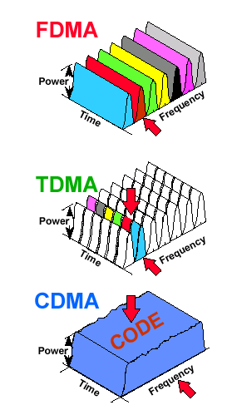
Radio Interfaces
Different in air interfaces
  Modulation and signaling
eg- GSM 900
  Uplink: 890-915 MHz
  Downlink: 935-960 MHz
  25MHz -> 124 carrier frequencies, spaced 200kHz apart
  One or more frequencies per base station
  ~270 kbps per carrier, divided into 8 channels = ~33kbps per channel
AMPS
TACS
NMT
IS-54B
IS-136
GSM
IS-95
IS-95B
WCDMA

Slide 12
GSM radio interface structure
935-960 MHz
124 channels (200 kHz)
downlink
frequency
890-915 MHz
124 channels (200 kHz)
uplink
higher GSM frame structures
time
GSM TDMA frame
1
2
3
4
5
6
7
8
4.615 ms
GSM time-slot (normal burst)
guard
space
guard
space
tail
user data
S
Training
S
user data
tail
3 bits
57 bits
1
26 bits
1
57 bits
3
546.5 µs
577 µs

Slide 13






2G Network:
Mobile Station & Base Station Subsystem
Mobile Station
SCP
Um
Abis
A
TDM
SIM
ME
BTS
BSC
PSTN
Mobile Equipment - International Mobile Equipment Identity (IMEI)
HLR
AUC
Base Station Subsystem (BSS)
Subscriber Identity Module (SIM)
Stores International Mobile Subscriber Identity (IMSI), identifying the subscriber, a secret key for authentication, and other user information
Can be protected by password
Allows personal mobility
Base Transceiver Station
(BTS) aka “Base Station”
Radio transceivers, defines cell
Radio­link protocols with Mobile
800, 900, 1800 and 1900 MHz frequencies most common
Multiple freq. carriers / BTS
Base Station Controller (BSC)
Radio­channel setup
Handovers
Frequency hopping
Transcoders (TCU) GSM codec from 13kbps to standard G.703/64 kbps towards MSC

Slide 14
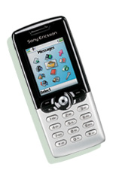
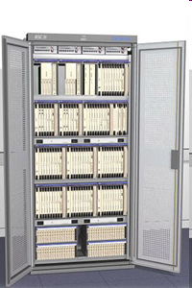
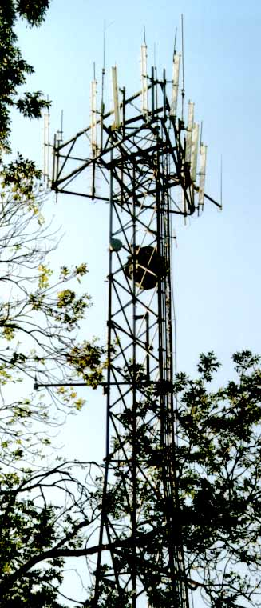
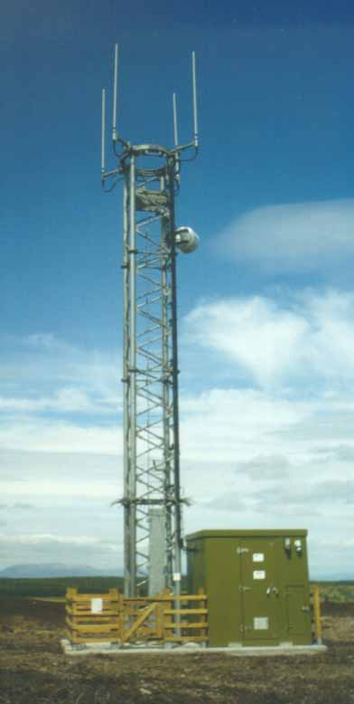
2G GSM – Base Station Subsystem
Um
Abis
A
TDM
TDM
E1/T1
BTS
BSC
PSTN
HLR
AUC
BTS
Depending on supplier, and design, urban or rural.
Around 10- 40 BTSs per BSC
Rough example - Around 1000 users per base station, 100 active - many variables
Base Station Controller
Including TRAU/TCU
Base Transceiver Stations

Slide 15
2G GSM – Core Network (Voice)
SCP
Um
Abis
BSC
A
TDM
ISUP/SS7
BTS
HLR
PSTN
AUC
SIM
VLR
EIR
Mobile Switching Center (MSC)
Phone switch plus:
mobile registration
call routing
inter MSC handovers
location updating
CDR creation
SS7 to PSTN
Home Location Register (HLR)
information of each subscriber, type, service
Current location of the subscriber
Logically 1 HLR per GSM network
Visitor Location Register (VLR)
selected information from the HLR for all mobiles in MSC area
Often bundled with MSC (VLR domain tied in with MSC coverage)
Queries assigned HLR
Signaling System No. 7 (SS7)
Packet signaling network
AuC – Auth. center
EIR – Equip ID register
SCP – Service control point

Slide 16
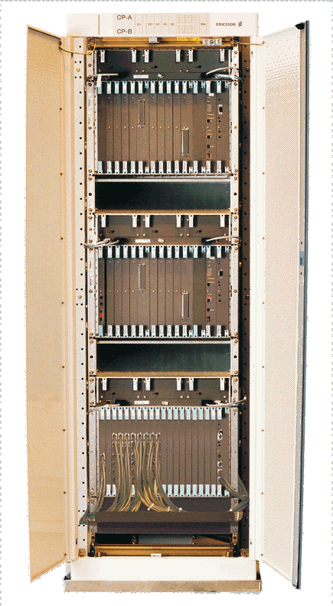
2G GSM – Mobile Switching Center
MSC
Connects to the fixed network (SS7)
Like a normal PSTN/ISDN switch with added mobile functionality:
Registration
Authentication
Location updating
Handovers
Integrates VLR
Call routing to roaming sub…
BSC
BSC
BSC
Depending on supplier, and design, urban or rural.
About 2-4 BSCs for each MSC
About MSC per 200K subscribers
Many variables
Notes:
Ericsson AXE

Slide 17
Agenda
Mobile overview and the transition to 3G
2.5G data networks
3G - phases of deployment. Focus areas:
  Layer 2/MPLS migration
  IP RAN and transition techniques
  IP Multimedia subsystem and QoS
  ‘Push to Talk’ example
  IPv6
WLAN integration options
Case studies

Slide 18
GPRS…. What is it?
General Packet Radio Service
  2.5G data service overlaid on an existing GSM network
  Mobile station uses up to 8 timeslots (channels) for GPRS data connection from Mobile Station
  Timeslots are shared amongst users (and voice)
Variable performance…
  Packet Random Access, Packet Switched
  Slotted Aloha Reservation / Contention handling
  Throughput depends on coding scheme, # timeslots etc
  From ~ 9 kbps min to max. of 171.8 kbps (in theory!)

Slide 19
Channel data rates determined by Coding Scheme
Use higher coding schemes (less coding, more payload) when radio conditions are good
20
CS 4
16
CS 3
12
Max throughput per GPRS channel
(netto bitrate, kbit/sec)
CS 2
8
CS 1
4
0
27dB
23dB
19dB
15dB
11dB
7dB
3dB
C/I
CS1 guarantees connectivity under all conditions (signaling and start of data)
CS2 enhances the capacity and may be utilised during the data transfer phase
CS3/CS4 will bring the highest speed but only under good conditions

Slide 20
Example GPRS data rates
(using Coding Scheme 2)
MS 1
MS 2
MS 3
MS 4
MS 5
MS 6
MS 7
MS 8
1 2 3 4 5 6 7 8
7 x ~ 13,4 kb/s = ~ 94 kbps
MS 1
MS 2
MS 3
MS 4
MS 5
MS 6
MS 7
MS 8
1 2 3 4 5 6 7 8
2 x ~ 13,4 kb/s = ~ 27 kbps
2 x ~ 13,4 kb/s = ~ 27 kbps
2 x ~ 13,4 kb/s = ~ 27 kbps

Slide 21









GPRS
General Packet Radio Service
Forwards IP from mobile device or laptop to Internet or corporate
IP can be used for any application, eg- MMS, to WAP gateway, etc or native net browsing
Handles handover for mobility (own standards, not mobile IP)
IPSec
WWW
LOGICAL LINK OVER RAN
GPRS TUNNEL ON IP
Dedicated Access

Slide 22
GPRS: General Packet Radio Service
Circuit Switched
SCP
BSC
& PCU
TDM
Um
Abis
A
BTS
PSTN
SIM
FR
HLR
AUC
Packet Switched Core
Gb
IP
Internet
Corporate
Gn
Gi
Packet Control Unit (PCU)
Forward data frames from TDM BSS to packet core
New hardware in BSC
Serving GPRS Support Node
(SGSN)
Packet transfer to, from serving area
Registration, authentication, mobility management / handover, CDRs
logical links to BTS, tunnel to GGSN
Gateway GPRS Support Node (GGSN)
Gateway to external IP networks (VPN/ISP etc)
IP network security
GPRS session mgmt, AAAA
CDRs for charging

Slide 23
GPRS Interfaces
VLR
HLR
G_{s}
G_{r}
G_{c}
BSS
G_{b}
SGSN
GGSN
G_{i}
PDN
G_{n}
G_{p}
G_{d}
GGSN
Ext. PLMN
SMS-
GMSC

Slide 24

GGSN
Gateway GPRS Support Node
BSC&PCU
BSC&PCU
E1/FR
IP network
One PCU per BSC
Typically regionally located
Depending on supplier, and traffic level (SA size)
5-20 SGSNs per network is typical today
Depending on supplier, and services offered
Either distributed design or centralised
2-10 GGSNs per network is typical today
(GGSNs can support 100,000s users today)

Slide 25


GPRS Protocol Stack
References:
23.060 GPRS
29.060 GTP
IPSec / L2TP
IP/MPLS
WWW
User-data
TCP/
IP
User-data
TCP/
IP
GTP
UDP
IP
User-data
TCP/
IP
UDP
UDP
UDP
Logical Link over RAN
GPRS tunnel on IP
Dedicated Access
Application
IP
IP
IP
SNDCP
Relay
SNDCP
GTP
-U
GTP
-U
LLC
LLC
UDP
UDP
Relay
RLC
RLC
BSSGP
BSSGP
IP
IP
MAC
MAC
Network
Network
L2
L2
L2
Service
Service
Gi
GSM RF
GSM RF
L1bis
L1bis
L1
L1
L1

Slide 26





GPRS Attach procedure eg- when turning on phone
1
SCP
BTS
BSC with PCU
GMSC
PSTN
ISDN
BSS
3
4
HLR
AUC
2
3
Public ISP
Corporate
MS send a requests to the SGSN to be attached to the network. Capabilities are stated multislot, ciphering algorithms, CS and/or PS required
RADIUS
2. Authentication between terminal and HLR
3. Subscriber data downloaded to MSC/VLR and SGSN
4. SGSN notifies terminal that it is attached, enters READY state

Slide 27
How to connect?
User selects which external network to connect to
  Or, may be automatically selected by application
APN = Access Point Name = identifies the external network
Internet provider A
juniper.net
blackberry.net
Resolved to a GGSN IP address by DNS at the SGSN
The established data session to the GGSN is called a PDP context
(Packet Data Protocol)

Slide 28
GPRS Tunneling Protocol (GTP)
GTP Packet Format
IP
UDP
GTP
Payload (IP or PPP)
Data flows from end mobile OS stack to host/server
Identify the GTP session
Identify the GTP’s well known port (3386)
Route between the SGSN and GGSN

Slide 29
PDP Context Activation aka “how is the connection set up?”
MT
1
SCP
BTS
BSC with PCU
GMSC
PSTN
ISDN
BSS
  juniper.net
HLR
AUC
29.061 GTP External Connectivity
2
Juniper.net
Juniper.net
MS requests PDP context activation type, APN, QoS
4
5
2. SGSN validates request against subscription information downloaded from HLR during GPRS Attach
RADIUS
3
3. APN sent to DNS, IP address(s) of suitable GGSNs returned
4. Logical connection using GTP created between SGSN and GGSN.
DNS
Public ISP
5. IP address allocated to Mobile via local pools, RADIUS or DHCP
- from operators own address range, or other
- fixed addresses held in HLR
- Proxy to RADIUS server in ISP or corporate domain

Slide 30
How do addresses get allocated?
Many ways! Eg-
  RADIUS indicated local pool
  RADIUS provided address (static or from RADIUS pool)
  DHCP server
  Locally configured pool / address
  From mobile operator or ISP address range
    Hosted model
    RADIUS proxy model
  Dynamic DNS can help with push model (joe@cellco.com)

Slide 31
PDP Context Activation Procedure
PDP creation procedure
MS
SGSN
DNS
GGSN
RADIUS
DHCP
NAS
1. Activate PDP Context Request
2. Security Functions
3a. DNS Request
3b. DNS Response
4. Create PDP Context Request
5a.Radius Authenticate Request
5b.Radius Authenticate Response
6a.DHCP Address Request
6b.DHCP Address Assignment
7.
IPSec Security Functions
8. Create PDP Context Response
9. Activate PDP Context Accept

Slide 32
PDP Context Activation Procedure -- PC to MS
Session to external notebook/PDA for “dial up” service
User
PC
MS
SGSN
1.
IrDA connection is established
2. PC user initiates a dial-up connection
3. PC sends the ATD*99# to the MS + APN configuration
4. MS begins PPP negotiation with the PC.
4a. LCP negotiation to configure the link.
4b. CHAP/PAP authentication phase
5. PC and MS enter IPCP negotiation
5a. PC sends in a IPCP request for a dynamic IP address
6a. Activate PDP Context Request
6b. Activate PDP Context Accept
5b. MS responds to the IPCP configure request
The PPP link is now established for data transfers.

Slide 33
Session to external notebook/PDA –
Authentication
PC/PDA
MS
SGSN
GGSN
AAA
CG
PDN
PPP session
AT commands
LCP
Authentication
IPCPConfReq
ActivatePDPContextReq
(APN,PCO)
CreatePDPContextReq
User enters login password
(APN, PCO)
AccessReq
AccessAcc
CreatePDPContextRes
ActivatePDPContextAcc
(IP @, PCO)
AccountingReq
(IP @, PCO)
(START)
IPCPConfAck
(IP @)
Encapsulation
De-encapsulation
Routing
Charging
User IP packet
G-CDR

Slide 34

Case Study –
Simple GPRS PoP design today
Border Router
IP/MPLS
Backbone
Other
Operators
Edge Router (PE)
Edge Router (PE)
Firewall
Firewall
Ethernet
VLAN Switch
Ethernet
VLAN Switch
Gi/Gn
DNS
DNS
NTP
2x GGSN
2x SGSN
NTP
DNS
DNS
Gb
nxE1/FR to BSC

Slide 35
Design issues – how to interconnect the GGSN into the IP/MPLS core?
Different approaches
Use flat IP network and tunnelling to end customer site (IPSEC, L2TP, GRE etc)
Static VR/VRFs meshed to local PE:
  Pros: simple model, allows external inline devices (eg FW)
  Cons: hard to manage/scale with redundancy (routing instances), local connections must be configured
GGSN becomes a native PE
  Pros: excellent scalability with mBGP, reduced operations (dynamic route propagation, VPN LSP setup etc)
  Cons: MPLS VPN required on GGSN

Slide 36
GPRS roaming
IR.33 Roaming
IR.34 GRX
Visited
HLR
Internet
Gp
GRX GPRS Roaming Exchange
(similar to an Internet peering exchange)
IPSec/Internet
LL
Home
Gp
Home services
HLR
Home Subscriber Services
HSS

Slide 37
What about EDGE?
(and what is it?!)

Slide 38
EDGE… also known as 2.75G
EDGE Enhanced Data Rates for Global Evolution
  Uses 8-PSK modulation in good conditions
  Increase throughput by 3x (8-PSK – 3 bits/symbol vs GMSK 1 bit/symbol)
  Fall back to GMSK modulation when far from the base station
  Combine with GPRS: EGPRS; up to ~ 473 Kbps. NB: GPRS & EGPRS can share time slots
New handsets / terminal equipment; additional hardware in the BTS
Core network and the rest remains the same
  TDMA (Time Division Multiple Access) frame structure
  200kHz carrier bandwidth allows cell plans to remain
  Initially no QoS; later GSM/EDGE Radio Access Network (GERAN) QoS added
EDGE access develops to connect to 3G core

Slide 39
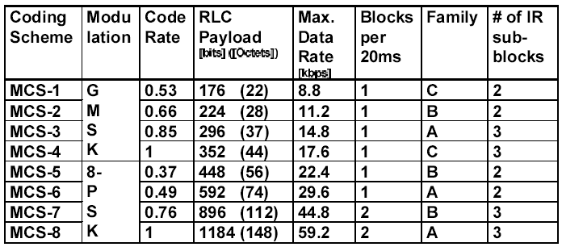
Coding Schemes for EGPRS
Theoretical max throughput = 59.2 x 8 timeslots = 473.8 kbps

Slide 40
EDGE deployments are now starting…
Seen by some as interim step to 3G, or short-medium alternative
Asia
  CSL Hong Kong, AIS Thailand were first to launch
  Many new deployments / active trials now
Rest of World
  TeliaSonera, Cingular Wireless, AT&T Wireless etc..
Nokia expects to ship > 100 million EDGE phones
by end 2005; 10 different models by 1H04
    Esa Harju, Nokia Global Director Marketing, December 2003

Slide 41
Agenda
Mobile overview and the transition to 3G
2.5G data networks
3G - phases of deployment. Focus areas:
  Layer 2/MPLS migration
  IP RAN and transition techniques
  IP Multimedia subsystem and QoS
  ‘Push to Talk’ example
  IPv6
WLAN integration options
Case studies

Slide 42
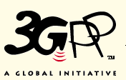
Standards groups for UMTS/WCDMA
3G development work has been driven by ETSI, UMTS Forum
WCDMA is the main 3G radio interface (driven initially by DoCoMo)
3GPP = 3G Partnership Program
  Produces specs for 3G system based on ETSI UTRA
  (Universal Terrestrial Radio Access Interface)
  Also develops further enhancements for GSM/GPRS/EDGE
  Several org partners including ETSI, CWTS – China Wireless Telecommunications Standards
  www.3gpp.org – eg- Juniper is an active member and contributor

Slide 43
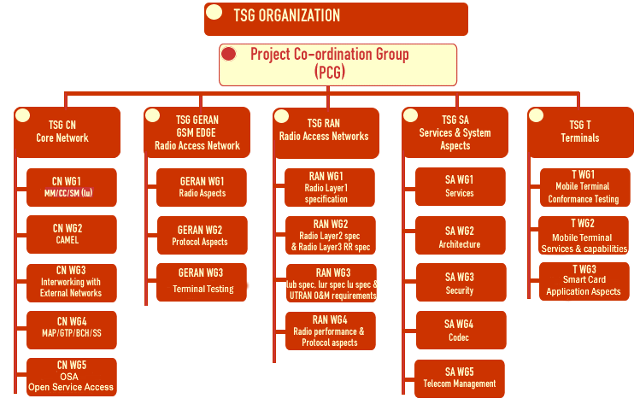
3GPP structure

Slide 44
3GPP Releases
3GPP Release 6
3GPP Release 5
3GPP Release 4
Versions of 3GPP Release 4
3GPP Release 99
Versions of
3GPP Release 1999
ETSI GSM
I
II
1990
1996
1999
2000
2001
2002
2003

Slide 45
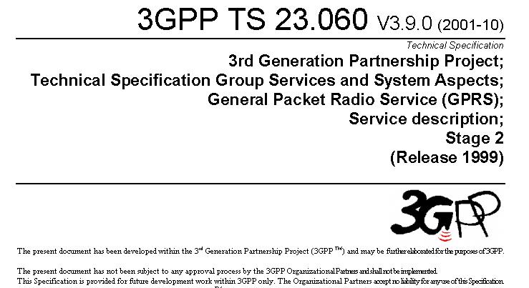
www.3gpp.org
1 presented for information
2 presented for approval
3 approved R99
4 approved R4
5 approved R5
6 approved R6
Major rev
Minor rev
Stage 1 Service Description
Stage 2 Architectural
Stage 3 Protocol detail

Slide 46
Involvement at 3GPP
Areas of focus:
Standards that impact Mobile backbone and GGSN infrastructure
  Inter-working of Core network with external networks
  3G Service policy management
  IPv6 and inter-working with IPv4
  IP Multimedia Subsystem
  IP Security
Transition of interfaces to IP
  Iu-CS, Nb, Signalling
  IP RAN
3GPP and WLAN Integration
  WLAN working group at SA2

Slide 47
Recent activity to date
TR 23.825 – IP Flow-based Charging (In conjunction with Ericsson)
  Definition of Rx interface between PDF and AF
TS 23.234 – 3GPP system to WLAN inter-working
  Supported discussions on:
    Network and Service selection, Visited to Home network tunneling
TS 29.061 – Inter-working between GPRS/UMTS networks with external PDN (in conjunction with Ericsson)
  Description on use of IPv6 in the user plane based on dynamic IPv6 Address Allocation (stateless address auto-configuration), RADIUS

Slide 48
Recent activity to date
TS 23.060 – GPRS Stage 2 (in conjunction with Ericsson)
  Allocation of unique prefixes to IPv6 terminals
TS 29.207 - Policy control procedures (in conjunction with Nortel)
  Supported creation of new WI for Stage 3 work on “Policy-based control of DiffServ Edge functions”
TS 29.207 (in conjunction with Nortel and Ericsson)
  Alignment of Go PIB with IETF DiffServ and Framework PIB

